Slide 1
NIHRIO at SemEval-2018 Task 3: A Simple and Accurate Neural Network Model for Irony Detection in Twitter
Thanh Vu, Dat Quoc Nguyen, Xuan-Son Vu, Dai Quoc Nguyen, Michael Catt and Michael Trenell
NIHRIO, Newcastle University, UK; The University of Melbourne, Australia; Umea University, Sweden; Deakin University, Australia

Slide 2
SemEval 2018 Task 3
Subtask 1 (A): Ironic vs non-ironic
This first subtask is a binary classification problem, in which we predict whether or not a tweet is ironic.
For example, “I just love when you test my patience!! #not” is ironic, but “Had no sleep and have got school now #not happy” is non-ironic.
Subtask 2 (B): Different types of irony
This second subtask is a multi-class classification problem, where we predict the correct label of a tweet from four classes: (1) non-irony, (2) verbal irony by means of a polarity contrast, (3) other verbal irony and (4) situational irony.

Slide 3
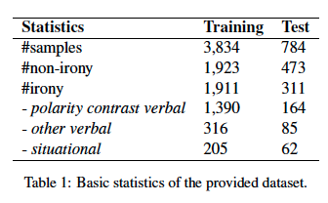
Data
Dataset
4,618 tweets (2,222 ironic + 2,396 non-ironic)
Preprocessing
emoji icons in a tweet are replaced by a describing text using the Python emoji package
https://pypi.python.org/pypi/emoji/
ironic hashtags, such as #not, #sarcasm, #irony, in the dataset have been removed
This makes difficult to correctly predict the label of a tweet.
For example, “@coreybking thanks for the spoiler!!!! #not
normalize each tweet from the dataset using a lexicon-based approach proposed by Han et al. (2012)
using a manually constructed normalization dictionary (e.g., “reeeaaalll” is normalized by “real’)
Tweet normalization is an important pre-processing step as there are around 15% of tweets containing 50% or more out-of-vocabulary tokens (Han and Baldwin, 2011).
replace all tagged users and urls by specific word tokens “<USER>” and “<URL>”, respectively

Slide 4
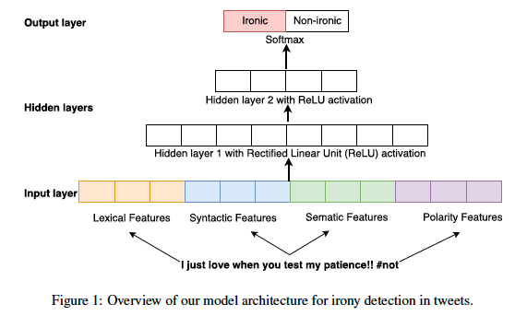
Model

Slide 5
Features
Lexical features
1-, 2-, and 3-grams in both word and character levels
For each type of n-grams, we utilize only the top 1,000 n-grams based on tf-idf
each n-gram appearing in a tweet becomes an entry in the feature vector with the corresponding feature value tf-idf
Use the number of characters and the number of words as features
Syntactic features
Use the NLTK toolkit to tokenize and annotate part-of-speech tags (POS tags) for all tweets in the dataset
Use all the POS tags with their corresponding tf-idf values as our syntactic features and feature values

Slide 6
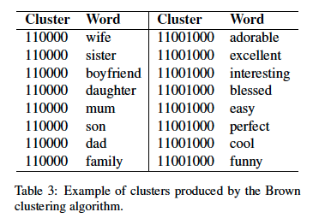
Features
Semantic features
Employ 300-dimensional pre-trained word embeddings from GloVe
compute a tweet embedding as the average of the embeddings of words in the tweet
Apply the latent semantic indexing to capture the underlying semantics of the dataset
each tweet is represented as a vector of 100 dimensions
Apply the Brown clustering algorithm
each word belongs to only one cluster
use the number of tweet words in each cluster as a feature
Polarity features
Use the number of polarity signals appearing in a tweet as the polarity features
positive words (e.g., love), negative words (e.g., awful), positive emoji icon and negative emoji icon
use the sentiment dictionaries provided by Hu and Liu (2004) to identify positive and negative words in a tweet
Use boolean features that check whether or not a negation word is in a tweet (e.g., not, n’t).

Slide 7
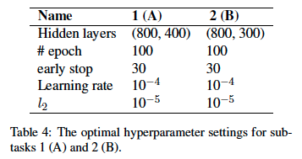
Implementation
Optimization
minimize the the cross-entropy loss with L2 regularization
follow a 10-fold cross-validation based voting strategy
split the training set into 10 folds
combine 9 folds to train a classification model and use the remaining fold to find the optimal hyper-parameters
In total, we have 10 classification models to produce 10 predicted labels for each test tweet. Then, we use the voting technique to return the final predicted label.

Slide 8
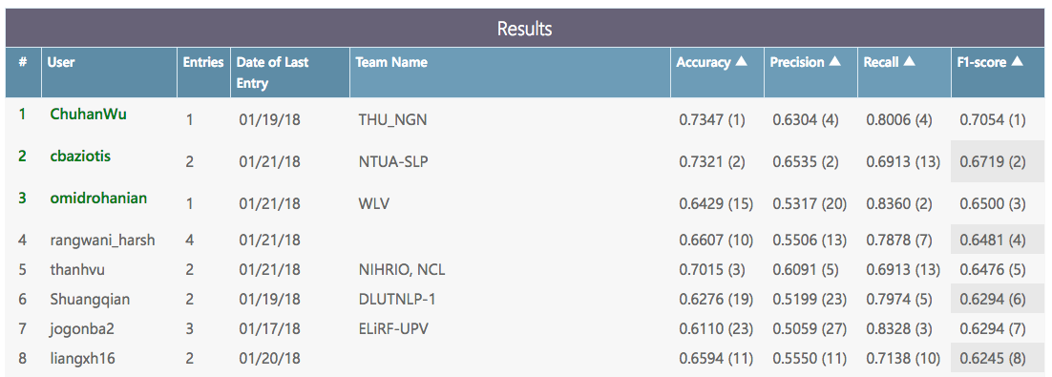
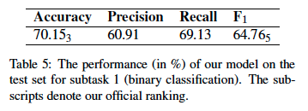
Results of Subtask 1

Slide 9
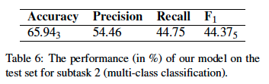
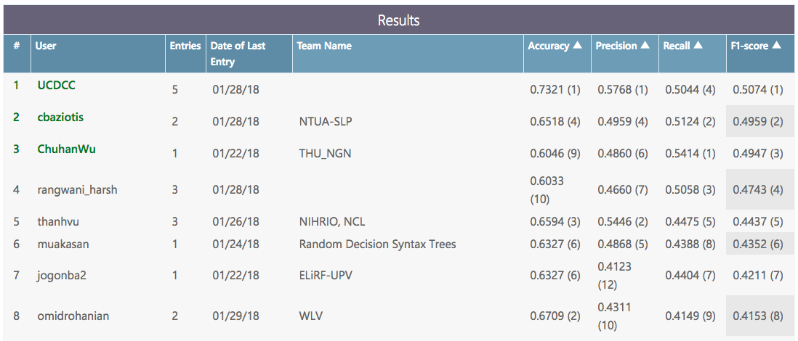
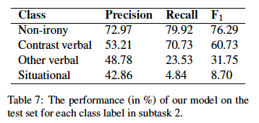
Results of Subtask 2

Slide 10
Discussion
have tried other neural network models
Long Short-Term Memory (LSTM) (Hochreiter and Schmidhuber, 1997)
Convolutional Neural Network (CNN) for relation classification (Kim, 2014)
LSTM achieves much higher performance than MLP does on the extended training set containing the ironic hashtags (about 92% vs 87% with 10-fold cross-validation using F1 on subtask 1). However, without the ironic hashtags, the performance is lower than MLP’s
also employed popular machine learning techniques
SVM (Hearst et al., 1998), Logistic Regression (Harrell, 2001), Ridge Regression Classifier (Le Cessie and Van Houwelingen, 1992)
none of them produces as good results as MLP does.
have also implemented ensemble models, such as voting, bagging and stacking.
We found that with 10-fold cross-validation based voting strategy, our MLP models produce the best irony detection and classification results.

